Slide 1
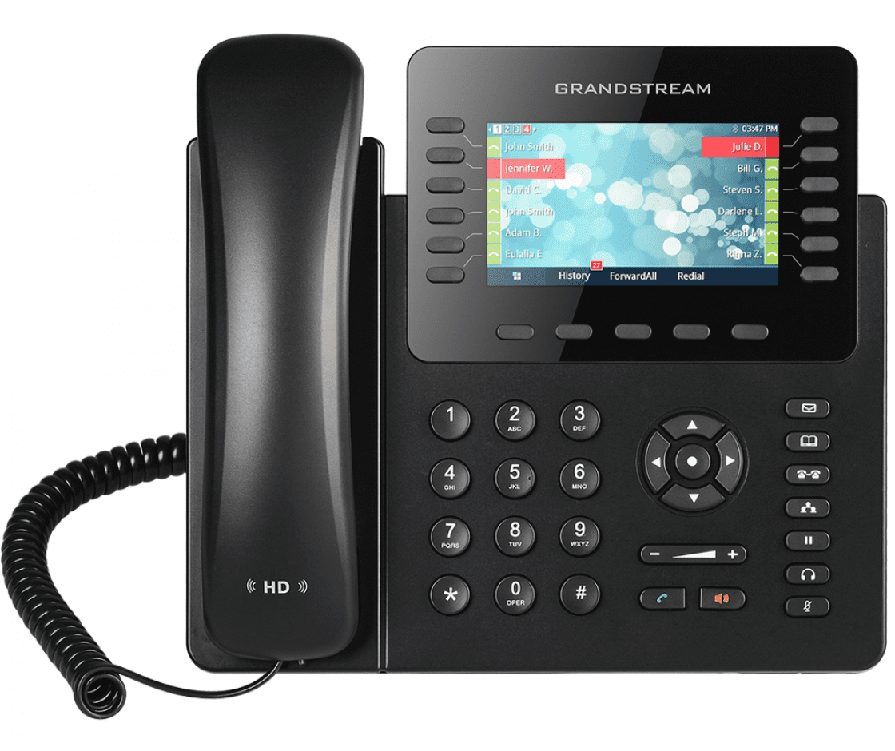
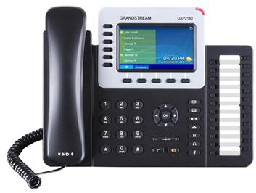
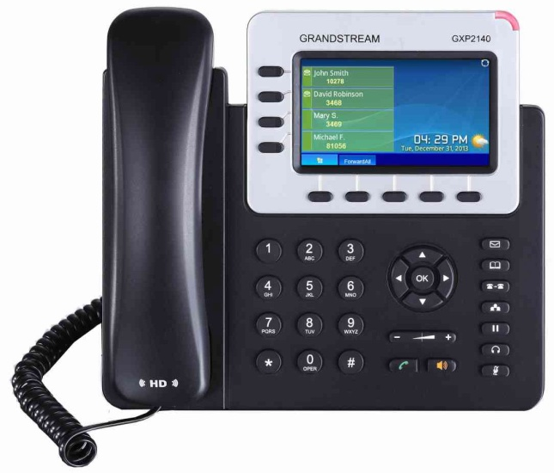
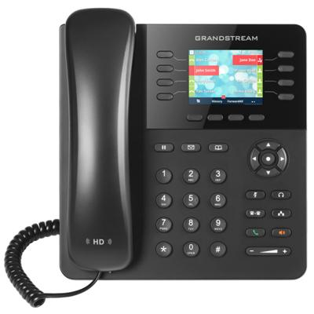
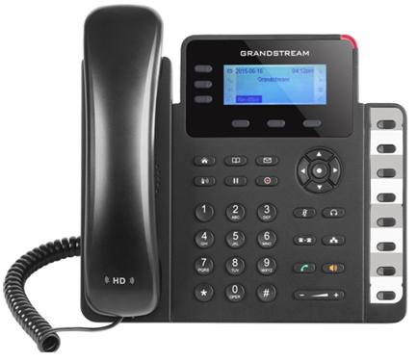
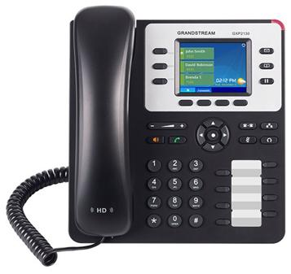
Grandstream GXP2170
Grandstream GXP2160
Grandstream 2140
4.3 inch (480x272) color-screen LCD
12 lines 6 SIP accounts, 5 programmable soft keys
Dual switched Gigabit ports, built-in PoE
48 programmable /customizable BLF/speed-dial keys
Built-in Bluetooth
HD audio handset and speakerphone
5-way audio conferencing for calls
4.3 inch (480x272) color-screen LCD
6 lines 6 SIP accounts, 5 programmable soft keys
Dual switched Gigabit ports, built-in PoE
24 programmable /customizable BLF/speed-dial keys
Built-in Bluetooth
HD audio handset and speakerphone
5-way audio conferencing for calls
4.3 inch (480x272) color-screen LCD
4 lines 4 SIP accounts, 5 programmable soft keys
Dual switched Gigabit ports, built-in PoE
24 programmable /customizable BLF/speed-dial keys
Built-in Bluetooth
HD audio handset and speakerphone
5-way audio conferencing for calls
Grandstream GXP2135
Grandstream GXP1630
Grandstream GXP2130 V2
2.8 inch (320x240) color-screen LCD
8 lines 4 SIP accounts, 4 programmable soft keys
Dual switched Gigabit ports, built-in PoE
32 programmable /customizable BLF/speed-dial keys
Built-in Bluetooth
HD audio on speakerphone and handset
Dual-switched Gigabit ports, integrated PoE
2.5 inch (132x64) backlit graphical LCD Display
3 lines 3 SIP accounts
3 programmable soft keys
Dual switched Gigabit ports, built-in PoE
8 programmable /customizable BLF/speed-dial keys
Built-in Bluetooth
HD audio on speakerphone and handset
Dual-switched Gigabit ports, integrated PoE
2.8 inch (320x240) color-screen LCD
3 lines 3 SIP accounts, 4 programmable soft keys
Dual switched Gigabit ports, built-in PoE
8 programmable /customizable BLF/speed-dial keys
Built-in Bluetooth
HD audio handset and speakerphone
4-way audio conferencing for calls

